Slide 1


Abstract Interpretation under
Speculative Execution
Meng Wu
Chao Wang
PLDI 2019

Slide 2


January 2018 – News
Affected a wide range of x86 processors
produced since 1995
Pictures are taken from https://meltdownattack.com/
Notes:
Our work is motivated by the tech news in January 2018, when a group of researchers uncovered two serious flaws in many of the x86 processors. The impact was big because they affected CPUs produced as far back as in 1995…

Slide 3




Black Magic Behind…
Cache timing side channel leak
Speculative execution
Notes:
As many of us already know, there are several techniques required for carrying out the exploits, but two important things are (1) cache timing side channel leak, and (2) an optimization inside the CPU called speculative execution. Unfortunately, existing technique for program analysis were not able to handle them.
What we would like to do, in this project, is to make static analysis, or more broadly, program verifiers, sound again in handling them.

Slide 4

Cache Timing
Main Memory
load reg1, var;
Address Value
Cache
FFFF
……
0005
0004
0003
……
11010111
……
10110100
11100001
01001101
……
11010011
11010001
Fast
Slow
The execution time difference may leak sensitive information
Notes:
Before talking about program analysis, let’s review how cache works.
Cache is a small storage area sitting between the fast CPU and the often slow main memory. If the CPU want to execute a load instruction, for instance, it would first check if the data is already in the cache. If the answer is yes, this is going to be very fast. Otherwise, the data has to be fetched from the main memory, and it’s going to be very slow. The difference in the execution time may be used the deduce sensitive information.
How? Here is a more concrete example (next slide).

Slide 5

Cache Timing Leaks
Cache status before “load”
void leak(uint8_t secret){
uint8_t SBox[256]={…};
……
load reg1, SBox[secret];
……
}
Cache
SBox[0],
……, SBox[63]
1-2 CPU cycles
Measure the execution
time of the load
100 CPU cycles
Secret < 64
Secret >= 64
Notes:
In this function, the input is secret. If we use the sensitive input as index to access an array, there may be danger. Assume that before executing the load instruction, the first 64 bytes of this array are already stored in the cache. Then, it is possible to infer the value range of secret, by measuring the execution time of this load instruction.
Why is that? If it takes 1-2 CPU cycles, obviously, the value of secret is less than 64, since it’s a cache hit.
But if it takes, say, 100 CPU cycles, obviously, the value of secret is greater than or equal to 64.
In other words, some information of the secret is leaked.

Slide 6

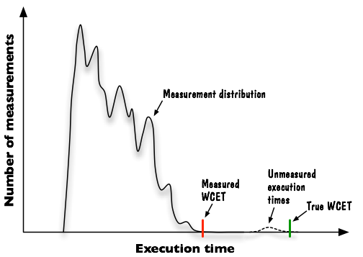
Execution Time Estimation
Real-time software that must meet deadline
Question:
Will the task miss its deadline?
[from Trevor Harmon]
Notes:
Even if you are not concerned with security attacks, there are other applications where analyzing the execution time is critical.
For example, in a real time system where software controls critical components, such as a robotic arm, you want to make sure that a computation task always meets its deadline. This is safety critical, but, how do you guarantee it?
The naïve approach is to ran some simulation or emulation, and measure the actual time taken to execute the program. In such a case, you will get a distribution, where this is the “measured” worst-case scenario. However, there are not-yet-observed worst cases.
So, ideally, you would want to perform a sound static program analysis.

Slide 7
Abstract Interpretation based Static Analysis
Application
  Estimate the execution time of real-time software
  Detect timing side channels in cryptographic software
Advantage
  Consider all feasible paths and input values
  Sound
Problem
  No longer sound under “speculative” execution
-- but only under “non-speculative” execution
We want to make it sound under speculative execution!
Notes:
In the past, static analysis, and in particular, abstract interpretation based static analysis, have been used in applications such as detecting side-channel leaks and estimating the worst-case scenarios in real-time software. The advantage is obvious: since it considers all possible program paths and input values, if it says that (1) there is no leak or (2) the task meets the deadline, it’s a sound proof. However, the soundness guarantee is valid only under “non-speculative” execution.
Our main contribution, in this work, is to extend the abstract interpretation framework, to make it sound again under speculative execution.

Slide 8

Outline
1. Background
Soundness in cache analysis
2. Motivation
Impact of speculative execution
3. Method
Virtual control flow & merging
4. Evaluation
Benchmarks and experiments
Notes:
In the remainder of this short talk, I will use an example to illustrate the impact of speculative execution on the soundness of the static analyzer. Then, I will highlight a few ideas underlying our method (due to time limit). Finally, I will show you the results of our experimental evaluation.

Slide 9
Motivating Example
char sbox[510], l1, l2, p;
reg char k; // secret related var
// sbox preload
for(reg int i=0;i<510; i+=1) load sbox[i];
if(p==0)
load l1;
else
load l2;
load sbox[k];
Notes:
Here is a small program, with an array and three variables stored in the main memory, and a register variable named k.

Slide 10
Motivating Example
char sbox[510], l1, l2, p;
reg char k; // secret related var
// sbox preload
for(reg int i=0;i<510; i+=1) load sbox[i];
if(p==0)
load l1;
else
load l2;
load sbox[k];
Fully Associative Cache
512 lines
Notes:
Suppose that we have a cache with 512 cache lines, and for simplicity, we assume that each line can only hold one byte (this doesn’t really matter).

Slide 11
Motivating Example
char sbox[510], l1, l2, p;
reg char k; // secret related var
// sbox preload
for(reg int i=0;i<510; i+=1) load sbox[i];
if(p==0)
load l1;
else
load l2;
load sbox[k];
Fully Associative Cache
512 lines
Notes:
In the normal situation, without speculative execution, the for-loop is going to fill up the first 510 cache lines.

Slide 12
Motivating Example
char sbox[510], l1, l2, p;
reg char k; // secret related var
// sbox preload
for(reg int i=0;i<510; i+=1) load sbox[i];
if(p==0)
load l1;
else
load l2;
load sbox[k];
Fully Associative Cache
sbox[0]
sbox[1]
510 lines
…
sbox[509]
Notes:
Now, there are only two cache lines left.

Slide 13
Motivating Example
char sbox[510], l1, l2, p;
reg char k; // secret related var
// sbox preload
for(reg int i=0;i<510; i+=1) load sbox[i];
if(p==0)
load l1;
else
load l2;
load sbox[k];
Fully Associative Cache
sbox[0]
sbox[1]
510 lines
…
sbox[509]
p
{l1, l2}
Notes:
Executing the if-else statement is going to fill up the remaining two cache lines: one line for “p” and one line for either “l1” or “l2”.

Slide 14
Motivating Example
char sbox[510], l1, l2, p;
reg char k; // secret
// sbox preload
for(reg int i=0;i<510; i+=1) load sbox[i];
if(p==0)
load l1;
else
load l2;
load sbox[k];
Fully Associative Cache
sbox[0]
sbox[1]
510 lines
…
sbox[509]
p
{l1, l2}
Must Hit !
Notes:
That’s why, when the last load instruction is executed, it’s going to be a cache hit -- the whole sbox array is cached.
If you are detecting side-channel leaks, then this should be considered as a “leak-free” program.
If you are estimating the worst-case execution time, the estimation is going to be very accurate.

Slide 15
Motivating Example
Under speculative execution
char sbox[510], l1, l2, p;
reg char k; // secret
// sbox preload
for(reg int i=0;i<510; i+=1) load sbox[i];
if(p==0)
load l1;
else
load l2;
load sbox[k];
Fully Associative Cache
l2
sbox[1]
510 lines
…
sbox[509]
p
l1
Notes:
However, under speculative execution. L1 and l2 may be both loaded to the cache. Why?
If the branch predictor inside the CPU mispredict, it may first execute the THEN-branch, and then backtrack, to execute the ELSE-branch. While the CPU can hide the impact on the program semantics, it produces some side-effects on the cache state (cleaning up would have been expensive).
The additional variable (l2) will evict the first byte of sbox out of cache.

Slide 16
Motivating Example
Under speculative execution
char sbox[510], l1, l2, p;
reg char k; // secret
// sbox preload
for(reg int i=0;i<510; i+=1) load sbox[i];
if(p==0)
load l1;
else
load l2;
load sbox[k];
Fully Associative Cache
l2
sbox[1]
510 lines
…
sbox[509]
p
l1
k=0: Miss
k!=0: Hit
Notes:
So, the timing behavior of the last instruction now depends on the value of k, the secret. By observing the execution time, an attacker may deduce some information of the secret. If k=0, it’s going to be a cache miss. But for other values, it’s going to be a cache hit.

Slide 17


Speculative Abstract Interpretation
Control Flow Analysis
Abstract Model
Generate Virtual CFG
Compilation
Notes:
Here is how we extend the existing abstract interpretation framework to make it sound again.
We assume that the input is a C program, and we use LLVM to construct its IR. Normally, we would throw the constructed CFG directly to the static analysis.
However, to model speculative speculation, we choose to augment the CFG, by adding some nodes and edges, to model the virtual control flow produced by speculative execution.
Then, we throw the virtual CFG to the static analyzer, and hope the static analyzer does mind handing it in the same way that it handles a normal CFG.

Slide 18
Speculative Abstract Interpretation
Control Flow Analysis
Cache Model
Generate Virtual CFG
Cache Analysis
Compilation
Notes:
If we plug in a cache model, this will be a sound speculative cache analysis procedure.

Slide 19
Speculative Abstract Interpretation
Control Flow Analysis
Pipeline Model
Generate Virtual CFG
Pipeline Analysis
Compilation
Notes:
If we plug in a pipeline model, this will be a sound speculative pipeline analysis procedure.

Slide 20
Speculative Abstract Interpretation
Control Flow Analysis
Power Model
Generate Virtual CFG
Power Analysis
Compilation
Notes:
If we plug in a power leakage model, this will be a sound speculative power side channel analysis procedure.
That’s why we say it’s a “unified” framework.

Slide 21
Outline
1. Background
Soundness in cache analysis
2. Motivation
Impact of speculative execution
3. Method
Virtual control flow & merging
4. Evaluation
Benchmarks and experiments
Notes:
Next, I will highlight the main ideas underlying our method.

Slide 22
Control Flow Graph (CFG)
br entry
cond
!cond
Then blocks
Else blocks
br exit
Notes:
This is a normal CFG, where the two branches are controlled by the if-condition.

Slide 23
Control Flow Graph (CFG)
br entry
cond
!cond
Then blocks
Else blocks
br exit
Notes:
So, it would either go to the left, or go to the right.

Slide 24
Virtual CFG
br entry
cond
!cond
Then blocks
Else blocks
br exit
Notes:
In a virtual CFG, both branches may be executed, as shown by the RED lines. Here, the branch predictor of the CPU made a mistake, so after executing a few instructions in the ELSE branch, the CPU backtracks and executes the THEN branch.
Since rollback may occur at any moment, there can be more than one possibilities.

Slide 25
Virtual CFG
br entry
1
Bounded Speculation Traces
cond
!cond
200 instructions
Then blocks
Else blocks
64 branches
boundary
1 error/exit etc.
br exit
Notes:
However, the speculation depth is bounded since the hardware resource inside a CPU is finite. The bound is often related to the number of speculative instructions. However, it’s not just the number, but also the type of instructions. If there are lots of branching instructions, the depth is going to be shallower. If there are some faults, such as division-by-zero, the depth is going to be even shallower.
Fortunately, our method can handle all of them. Given a configuration file of a specific CPU platform, our method will construct the virtual CFG accordingly, to soundly model the impact of speculative execution on that platform.

Slide 26
Generating Virtual CFG
br entry
1
Bounded Speculation Traces
cond
!cond
Then blocks
Else blocks
br exit
Notes:
In static analysis, we normally don’t explore each control flow path separately, since it will lead to state space explosion. So, an important problem is to determine when to merge, and how to merge, all these control flow paths.
Here, one option is to keep all the RED virtual flow paths separately, until they reach the exit node, and merge them with the normal control flow.

Slide 27
Generating Virtual CFG
br entry
1
Bounded Speculation Traces
cond
!cond
2
Then blocks
Else blocks
Merging Point after roll-back
br exit
Notes:
Another option is to more aggressively merge. Right after rollback, we can merge the virtual flow with the normal flow, and propagate the merged state downward.

Slide 28
Generating Virtual CFG
Nearest Common Point of speculation traces
br entry
1
Bounded Speculation Traces
cond
!cond
2
Then blocks
Else blocks
Merging Point at end-specu
br exit
Notes:
There is also a middle ground. Right after rollback, we merge all the virtual flow paths, but keep the merged state separate from the main flow. We propagate both states down and then merge them.
We have thoroughly evaluated all these different merging strategies, and based on the current set of benchmark programs, we have reached the conclusion that, often times, the middle ground is the best.

Slide 29
Generating Virtual CFG
br entry
1
Bounded Speculation Traces
cond
!cond
2
Then blocks
Else blocks
Just-in-Time Merging Point
br exit
Notes:
We call this merging strategy “just-in-time” merging.

Slide 30
Generating Virtual CFG
br entry
1
Bounded Speculation Traces
cond
!cond
2
Then blocks
Else blocks
Just-in-Time Merging Point
bound
3
Dynamic Bound Analysis
br exit
Notes:
Another important idea is “dynamic bounding” of the speculation depth. If we know, before hand, that a certain branch condition relies only on variables that are always loaded into the cache, then the speculative execution depth is going to be a lot shallower. This leads to fewer virtual flow paths, and therefore, more accurate analysis results. However, in general, we don’t know which branch condition leads to must-hits. After all, we are doing must-hit analysis.

Slide 31
Generating Virtual CFG
br entry
1
Bounded Speculative Traces
cond
!cond
2
Then blocks
Else blocks
Just-in-Time Merging Point
smaller
bound
3
Dynamic Bound Analysis
br exit
Notes:
However, as our must-hit analysis continues, gradually, we may really that some branch conditions are related to must-hits. In such cases, we can dynamically reduce the speculative execution depths, by using a smaller bound.

Slide 32
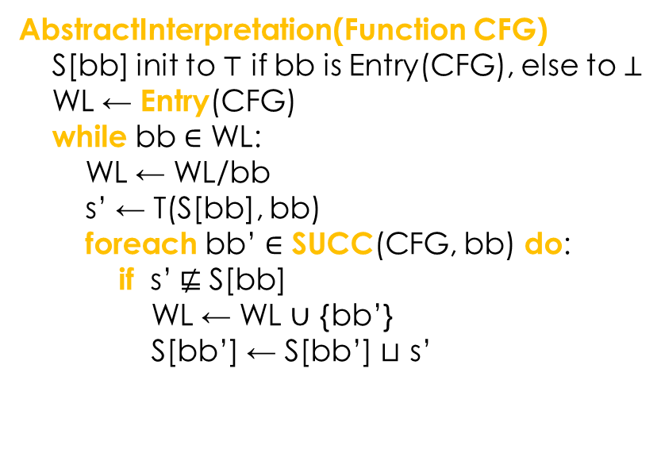
Abstract Interpretation (baseline)
AbstractInterpretation(Function CFG)
S[bb] init to $⊤$ if bb is Entry(CFG), else to $⊥$
WL ← Entry(CFG)
while bb $∈$ WL:
WL ← WL/bb
s’ ← T(S[bb], bb)
foreach bb’ $∈$ SUCC(CFG, bb) do:
if s’$⋢$ S[bb]
WL ← WL $∪$ {bb’}
S[bb’] ← S[bb’] $⊔$ s’
Notes:
I am not supposed to show you the pseudo code, since there is no time to digest the algorithm in this type of short talks. What I really want to do, here, is to flip through the slides quickly, so you get an idea how much we have modified the baseline abstract interpretation framework.
The short answer is “not much” – our modification is minimal, and that’s a virtue.

Slide 33
Abstract Interpretation (baseline)
AbstractInterpretation(Function CFG)
S[bb] init to $⊤$ if bb is Entry(CFG), else to $⊥$
WL ← Entry(CFG)
while bb $∈$ WL:
WL ← WL/bb
s’ ← T(S[bb], bb)
foreach bb’ $∈$ SUCC(CFG, bb) do:
if s’$⋢$ S[bb]
WL ← WL $∪$ {bb’}
S[bb’] ← S[bb’] $⊔$ s’
Notes:
The baseline algorithm relies on a standard work-list based iteration to compute, for each program location, an over-approximated set of program states.

Slide 34
Abstract Interpretation (baseline)
AbstractInterpretation(Function CFG)
S[bb] init to $⊤$ if bb is Entry(CFG), else to $⊥$
WL ← Entry(CFG)
while bb $∈$ WL:
WL ← WL/bb
s’ ← T(S[bb], bb)
foreach bb’ $∈$ SUCC(CFG, bb) do:
if s’$⋢$ S[bb]
WL ← WL $∪$ {bb’}
S[bb’] ← S[bb’] $⊔$ s’
Notes:
Within each iteration, it takes the current states, pushes them through the “transfer function”, to compute the next states as a result of executing a basic block of instructions.

Slide 35
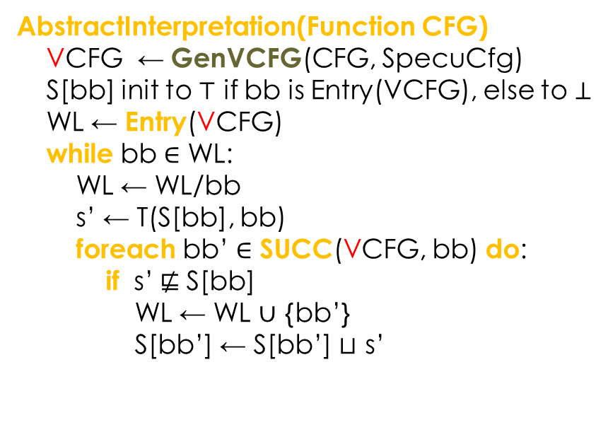
Abstract Interpretation (speculative)
AbstractInterpretation(Function CFG)
VCFG ← GenVCFG(CFG, SpecuCfg)
S[bb] init to $⊤$ if bb is Entry(VCFG), else to $⊥$
WL ← Entry(VCFG)
while bb $∈$ WL:
WL ← WL/bb
s’ ← T(S[bb], bb)
foreach bb’ $∈$ SUCC(VCFG, bb) do:
if s’$⋢$ S[bb]
WL ← WL $∪$ {bb’}
S[bb’] ← S[bb’] $⊔$ s’
Notes:
To model speculative execution, the minimal modification we need is to replace the normal CFG with VCFG, which has both normal and virtual flows.
This will actually be a sound analysis, although it’s not going to be very good, since there is no special handling of merging, bounding, and other details.

Slide 36
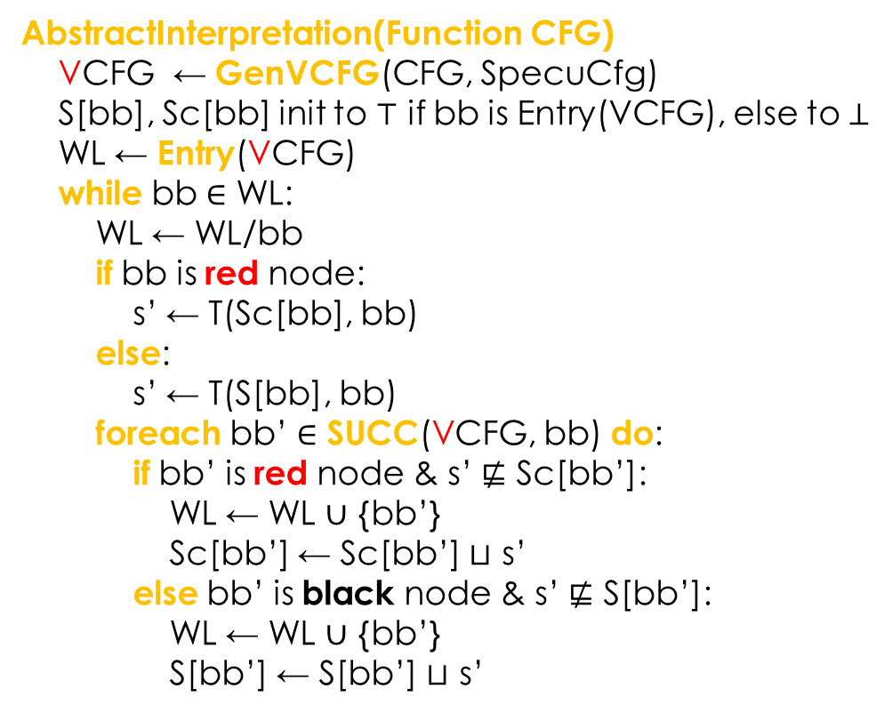
Abstract Interpretation (speculative, merging)
AbstractInterpretation(Function CFG)
VCFG ← GenVCFG(CFG, SpecuCfg)
S[bb], Sc[bb] init to $⊤$ if bb is Entry(VCFG), else to $⊥$
WL ← Entry(VCFG)
while bb $∈$ WL:
WL ← WL/bb
if bb is red node:
s’ ← T(Sc[bb], bb)
else:
s’ ← T(S[bb], bb)
foreach bb’ $∈$ SUCC(VCFG, bb) do:
if bb’ is red node & s’ $⋢$ Sc[bb’]:
WL ← WL $∪$ {bb’}
Sc[bb’] ← Sc[bb’] $⊔$ s’
else bb’ is black node & s’ $⋢$ S[bb’]:
WL ← WL $∪$ {bb’}
S[bb’] ← S[bb’] $⊔$ s’
Notes:
In the actual algorithm, we keep the normal and virtual flow paths separate, and only merge until they reach certain program points.
To do that, we assign program sates two different colors: black for normal program states, and red for speculative program states.

Slide 37

Speculative Cache Analysis
AbstractInterpretation(Function CFG)
VCFG ← GenVCFG(CFG, SpecuCfg)
S[bb], Sc[bb] init to $⊤$ if bb is Entry(VCFG), else to $⊥$
WL ← Entry(VCFG)
while bb $∈$ WL:
WL ← WL/bb
if bb is red node:
s’ ← T(Sc[bb], bb)
else:
s’ ← T(S[bb], bb)
foreach bb’ $∈$ SUCC(VCFG, bb) do:
if bb’ is red node & s’ $⋢$ Sc[bb’]:
WL ← WL $∪$ {bb’}
Sc[bb’] ← Sc[bb’] $⊔$ s’
else bb’ is black node & s’ $⋢$ S[bb’]:
WL ← WL $∪$ {bb’}
S[bb’] ← S[bb’] $⊔$ s’
a
Young
age
b
c
d
a
b
a
READ b
Young
age
b
b
a
c
c
c
d
d
d
a
e
b
c
c
a
d
d
{}
{}
{a,c}
d
Notes:
For cache analysis, the program states are actually cache states: we don’t care about values of the normal program variables, or relationships among these variables. We only care about, for each variable, the ages of their corresponding cache lines.
In this figure, a is the youngest and d is the oldest in this cache. After executing the instruction “READ b”, variable be becomes the youngest, a becomes older, while c and d remain unchanged.
When two program paths are merged, the resulting state contains a variable only if that variable appears in both of the two states – since what we are doing is a MUST-HIT analysis.

Slide 38





Optimized Merging (standard)
x
t
y
z
z
x
k
y
{ }
ref b
$$y$$
$$\{ \}$$
$$\{ \}$$
{x,z}
$$\{ \}$$
k
$$\{x,z\}$$
Notes:
This is the original merge operation. It is fast. However, it is not very accurate. For example, in the end, we don’t know which variable might be stored in the second cache line.

Slide 39







Optimized Merging (improved)
x
t
y
z
z
x
k
y
$∃$x, $∃$t
ref b
$∃$x, $y$
$$∃y,∃\text{z}$$
$$∃x,∃\text{t}$$
{x,z}
$$∃z$$
$∃k,$ k
$$∃k,x,z$$
Touzeau, Maiza, Monniaux, and Reineke.
Ascertaining uncertainty for efficient exact cache analysis.
CAV 2017
Notes:
Here is a refined merge operation. In addition to the age, we also have some additional information, for example, that the second cache line might be storing the variable “e”. This is going to be very useful in some cases.

Slide 40
Optimized Merging (example: standard)
a
[a, Ʇ, Ʇ, Ʇ]
a
[b, a, Ʇ, Ʇ]
b
c
[c, a, Ʇ, Ʇ]
[Ʇ, a, Ʇ, Ʇ]
b
c
[b, Ʇ, a, Ʇ]
b
c
[c, Ʇ, a, Ʇ]
[Ʇ, Ʇ, a, Ʇ]
[b, Ʇ, Ʇ, a]
b
c
[c, Ʇ, Ʇ, a]
…
[Ʇ, Ʇ, Ʇ, a]
Notes:
Consider a loop over an if-else statement, where the two branches either access b or access c. We know that, since only 3 variables are accessed, we only need 3 cache lines.
However, with the standard merging operation, the analyzer will actually report that a will be evicted from the cache.

Slide 41










Optimized Merging (example: improved)
a
[{$∃a$,a}, Ʇ, Ʇ, Ʇ]
a
[{$∃$b,b}, {$∃a$,a}, Ʇ, Ʇ]
b
c
[{$∃c$,c}, {$∃a$,a}, Ʇ, Ʇ]
[{$∃$b, $∃$c}, {$∃a$,a}, Ʇ, Ʇ]
b
c
[{$∃$b,b}, {$∃a$,$∃$c}, a, Ʇ]
b
c
[{$∃c$,c},{$∃a$,$∃$b}, a, Ʇ]
[{$∃$b,$∃c$}, {$∃a$}, a, Ʇ]
[{$∃$b,b}, {$∃a$,$∃$c}, a, Ʇ]
b
c
[{$∃c$,c}, {$∃a$,$∃$b}, a, Ʇ]
…
[{$∃$b,$∃c$}, {$∃$a}, a, Ʇ]
Notes:
If we use our refined merge function, the inaccurate results will not be reported. With the help of the additional information, we know that both b and c are going to be stored in the first two cache lines.

Slide 42


Optimized Merging (example: improved)
a
[{$∃a$,a}, Ʇ, Ʇ, Ʇ]
a
[{$∃$b,b}, {$∃a$,a}, Ʇ, Ʇ]
b
c
[{$∃c$,c}, {$∃a$,a}, Ʇ, Ʇ]
[{$∃$b, $∃$c}, {$∃a$,a}, Ʇ, Ʇ]
b
c
[{$∃$b,b}, {$∃a$,$∃$c}, a, Ʇ]
b
c
[{$∃c$,c},{$∃a$,$∃$b}, a, Ʇ]
[{$∃$b,$∃c$}, {$∃a$}, a, Ʇ]
[{$∃$b,b}, {$∃a$,$∃$c}, a, Ʇ]
b
c
[{$∃c$,c}, {$∃a$,$∃$b}, a, Ʇ]
…
[{$∃$b,$∃c$}, {$∃$a}, a, Ʇ]
Reached a fixed point!
Notes:
After three iterations, the cache state reaches a fixed point.

Slide 43
Standard Merging
AbstractInterpretation(Function CFG)
VCFG ← GenVCFG(CFG, SpecuCfg)
S[bb], Sc[bb] init to $⊤$ if bb is Entry(VCFG), else to $⊥$
WL ← Entry(VCFG)
while bb $∈$ WL:
WL ← WL/bb
if bb is red node:
s’ ← T(Sc[bb], bb)
else:
s’ ← T(S[bb], bb)
foreach bb’ $∈$ SUCC(VCFG, bb) do:
if bb’ is red node & s’ $⋢$ Sc[bb’]:
WL ← WL $∪$ {bb’}
Sc[bb’] ← Sc[bb’] $⊔$ s’
else bb’ is black node & s’ $⋢$ S[bb’]:
WL ← WL $∪$ {bb’}
S[bb’] ← S[bb’] $⊔$ s’
Standard merging
Notes:
To recap, here is the pseudo code with standard merging.

Slide 44

Optimized Merging
AbstractInterpretation(Function CFG)
VCFG ← GenVCFG(CFG, SpecuCfg)
S[bb], Sc[bb] init to $⊤$ if bb is Entry(VCFG), else to $⊥$
WL ← Entry(VCFG)
while bb $∈$ WL:
WL ← WL/bb
if bb is red node:
s’ ← T(Sc[bb], bb)
else:
s’ ← T(S[bb], bb)
foreach bb’ $∈$ SUCC(VCFG, bb) do:
if bb’ is red node & s’ $⋢$ Sc[bb’]:
WL ← WL $∪$ {bb’}
Sc[bb’] ← Sc[bb’] $⊔_{∃}$ s’
else bb’ is black node & s’ $⋢$ S[bb’]:
WL ← WL $∪$ {bb’}
S[bb’] ← S[bb’] $⊔_{∃}$ s’
Optimized merging
Notes:
Here is the optimized merging.

Slide 45

Optimized Merging (plus Widening)
AbstractInterpretation(Function CFG)
VCFG ← GenVCFG(CFG, SpecuCfg)
S[bb], Sc[bb] init to $⊤$ if bb is Entry(VCFG), else to $⊥$
WL ← Entry(VCFG)
while bb $∈$ WL:
WL ← WL/bb
if bb is red node:
s’ ← T(Sc[bb], bb)
else:
s’ ← T(S[bb], bb)
foreach bb’ $∈$ SUCC(VCFG, bb) do:
if bb’ is red node & s’ $⋢$ Sc[bb’]:
WL ← WL $∪$ {bb’}
Sc[bb’] ← Sc[bb’] $∇_{∃}$ s’
else bb’ is black node & s’ $⋢$ S[bb’]:
WL ← WL $∪$ {bb’}
S[bb’] ← S[bb’] $∇_{∃}$ s’
Optimized merging
&
widening
Notes:
In addition, we also add “widening” to deal with the converging of the fixed-point computation under loops.

Slide 46
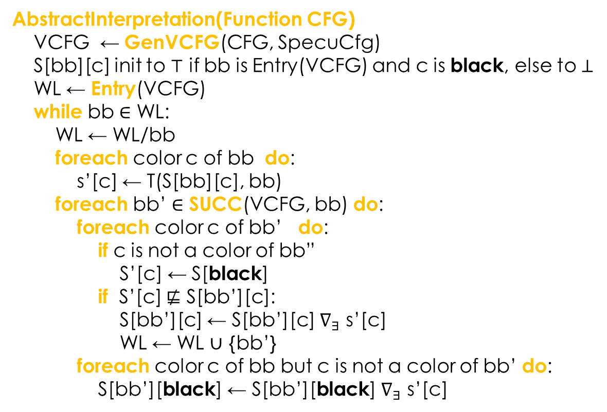
Handling Nested Branches
AbstractInterpretation(Function CFG)
VCFG ← GenVCFG(CFG, SpecuCfg)
S[bb][c] init to $⊤$ if bb is Entry(VCFG) and c is black, else to $⊥$
WL ← Entry(VCFG)
while bb $∈$ WL:
WL ← WL/bb
foreach color c of bb do:
s’[c] ← T(S[bb][c], bb)
foreach bb’ $∈$ SUCC(VCFG, bb) do:
foreach color c of bb’ do:
if c is not a color of bb”
S’[c] ← S[black]
if S’[c] $⋢$ S[bb’][c]:
S[bb’][c] ← S[bb’][c] $∇_{∃}$ s’[c]
WL ← WL $∪$ {bb’}
foreach color c of bb but c is not a color of bb’ do:
S[bb’][black] ← S[bb’][black] $∇_{∃}$ s’[c]
Notes:
We also handle nested branches, by assigning one color to each speculatively executed flow. There can be many colors, but the structure of the algorithm remains unchanged.

Slide 47
Outline
1. Background
Soundness in cache analysis
2. Motivation
Impact of speculative execution
3. Method
Virtual control flow & merging
4. Evaluation
Benchmarks and experiments
Notes:
Next, I will show you the results of our experimental evaluation.

Slide 48
Evaluation
RQ1: Is our method indeed more accurate than prior techniques (non-speculative analyzers)?
RQ2: Is our method efficient enough in practice?
for Timing Side Channel Detection
for WCET Estimation
Alpha 21264 processor, 512 cache lines, 64 bytes per line
GEM5 (O3CPU)
Notes:
Our experiments were designed to answer the following two questions:…
The benchmarks are for two applications:…

Slide 49
Results: Timing Leak Detection
Program |  |  |  | Non-Speculative |  | Speculative
Name | Source | Loc | BuffSize(Byte) | Time(s) | Leaky? | Time(s) | Leaky?
hash | Hpn-ssh | 320 | 31,808 | 0.67 | No | 1.15 | Yes
encoder | libTomCrypt | 134 | 32,512 | 0.03 | No | 0.1 | Yes
chacha20 | libTomCrypt | 776 | 26,304 | 1.18 | No | 9.24 | Yes
ocb | libTomCrypt | 377 | 31,616 | 0.1 | No | 0.68 | Yes
aes | libTomCrypt | 1838 | 32,768 | 0.08 | No | 2.13 | No
str2key | openssl | 385 | 32,768 | 0.01 | No | 0.01 | No
des | openssl | 1051 | 0 | 1.49 | No | 14.2 | Yes
seed | linux-tegra | 487 | 32,768 | 0.01 | No | 0.07 | No
camellia | linux-tegra | 1324 | 32,768 | 0.35 | No | 6.35 | No
salsa | linux-tegra | 279 | 32,768 | 0.02 | No | 0.06 | No
Notes:
Here are the results of our timing leak detection experiments. The buffer size are related to the client programs, which invoke the cryptograph programs.

Slide 50
Results: Timing Leak Detection
Program |  |  |  | Non-Speculative |  | Speculative
Name | Source | Loc | BuffSize(Byte) | Time(s) | Leaky? | Time(s) | Leaky?
hash | Hpn-ssh | 320 | 31,808 | 0.67 | No | 1.15 | Yes
encoder | libTomCrypt | 134 | 32,512 | 0.03 | No | 0.1 | Yes
chacha20 | libTomCrypt | 776 | 26,304 | 1.18 | No | 9.24 | Yes
ocb | libTomCrypt | 377 | 31,616 | 0.1 | No | 0.68 | Yes
aes | libTomCrypt | 1838 | 32,768 | 0.08 | No | 2.13 | No
str2key | openssl | 385 | 32,768 | 0.01 | No | 0.01 | No
des | openssl | 1051 | 0 | 1.49 | No | 14.2 | Yes
seed | linux-tegra | 487 | 32,768 | 0.01 | No | 0.07 | No
camellia | linux-tegra | 1324 | 32,768 | 0.35 | No | 6.35 | No
salsa | linux-tegra | 279 | 32,768 | 0.02 | No | 0.06 | No
Notes:
While static analyzers that do not model speculative execution say that the programs are leak free, …

Slide 51
Results: Timing Leak Detection
Program |  |  |  | Non-Speculative |  | Speculative
Name | Source | Loc | BuffSize(Byte) | Time(s) | Leaky? | Time(s) | Leaky?
hash | Hpn-ssh | 320 | 31,808 | 0.67 | No | 1.15 | Yes
encoder | libTomCrypt | 134 | 32,512 | 0.03 | No | 0.1 | Yes
chacha20 | libTomCrypt | 776 | 26,304 | 1.18 | No | 9.24 | Yes
ocb | libTomCrypt | 377 | 31,616 | 0.1 | No | 0.68 | Yes
aes | libTomCrypt | 1838 | 32,768 | 0.08 | No | 2.13 | No
str2key | openssl | 385 | 32,768 | 0.01 | No | 0.01 | No
des | openssl | 1051 | 0 | 1.49 | No | 14.2 | Yes
seed | linux-tegra | 487 | 32,768 | 0.01 | No | 0.07 | No
camellia | linux-tegra | 1324 | 32,768 | 0.35 | No | 6.35 | No
salsa | linux-tegra | 279 | 32,768 | 0.02 | No | 0.06 | No
Notes:
Our new method has detected leaks. We have validated the results, using a combination of manual inspection and GEM5 simulation, to confirm that these are indeed leaks.

Slide 52
Results: Timing Leak Detection
Program |  |  |  | Non-Speculative |  | Speculative
Name | Source | Loc | BuffSize(Byte) | Time(s) | Leaky? | Time(s) | Leaky?
hash | Hpn-ssh | 320 | 31,808 | 0.67 | No | 1.15 | Yes
encoder | libTomCrypt | 134 | 32,512 | 0.03 | No | 0.1 | Yes
chacha20 | libTomCrypt | 776 | 26,304 | 1.18 | No | 9.24 | Yes
ocb | libTomCrypt | 377 | 31,616 | 0.1 | No | 0.68 | Yes
aes | libTomCrypt | 1838 | 32,768 | 0.08 | No | 2.13 | No
str2key | openssl | 385 | 32,768 | 0.01 | No | 0.01 | No
des | openssl | 1051 | 0 | 1.49 | No | 14.2 | Yes
seed | linux-tegra | 487 | 32,768 | 0.01 | No | 0.07 | No
camellia | linux-tegra | 1324 | 32,768 | 0.35 | No | 6.35 | No
salsa | linux-tegra | 279 | 32,768 | 0.02 | No | 0.06 | No
Notes:
For this des cipher, even the original program (with any client program) contains a user controlled buffer. So we don’t even need a additional buffer.

Slide 53
Results: Execution Time Estimation
Program |  |  | Non-Speculative |  | Speculative
Name | Source | Loc | Time(s) | #Miss | Time(s) | #Miss | #Specu Miss | #Specu Br | #Iteration
adpcm | WCET@mdh | 910 | 0.98 | 25 | 12.7 | 32 | 17 | 75 | 173
susan | MiBench | 2140 | 19.4 | 17 | 248.4 | 26 | 17 | 113 | 464
layer3 | MiBench | 2233 | 7.24 | 78 | 65.5 | 88 | 35 | 241 | 374
jcmarker | JPEG lib | 1444 | 0.20 | 22 | 3.4 | 26 | 11 | 37 | 72
jdmarker | JPEG lib | 2068 | 2.89 | 21 | 15.2 | 78 | 55 | 193 | 726
jcphuff | JPEG lib | 694 | 0.03 | 12 | 0.44 | 12 | 13 | 25 | 32
gtk | GNOME | 949 | 19.9 | 16 | 274.8 | 19 | 13 | 77 | 190
g72 | mediaBench | 608 | 0.16 | 6 | 0.94 | 9 | 4 | 41 | 79
vga | mediaBench | 386 | 0.05 | 4 | 0.06 | 4 | 3 | 3 | 3
stc | mediaBench | 492 | 0.13 | 10 | 0.96 | 23 | 14 | 39 | 105
Notes:
Similarly, for execution time estimation: if the analyzer does not model speculative execution, it would say that a program has at most 25 cache misses (for adpcm), when in fact, it may have as many as 32 cache misses. In other words, the existing methods are unsound, and that’s dangerous!

Slide 54
Results: Different Merging Strategies
Notes:
Here are results of comparing the different merging strategies. Most of the time, our JIT merging strategy is the best: it is more accurate (fewer cache misses), and it is faster, even though the roll-back merging strategy is more aggressive in merging the virtual flow paths.

Slide 55
Conclusion
A unified framework for abstract interpretation to handle speculative execution
  Sound, efficient, and (indeed) more accurate than prior non-speculative analysis techniques
Future work
  Handling other micro-architectural features of the computing device, as well as other types of side channels
Jingbo Wang, et al.,
Mitigating power side channels during compilation,
ESEC/FSE 2019
Notes:
To conclude, we propose a unified framework for extending abstract interpretation so that it can handle speculative execution soundly.
https://bitbucket.org/mengwu/timingsyn/src/master/
For future work, we would like to take a look at other micro-architectural features of the CPU, and evaluate their impact on non-functional properties such as timing and power side channels.
In fact, we have already made some progress, including the following paper, to appear in ESEC/FSE in August.

Slide 56


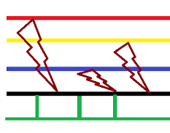

Other Side Channels
Power
Consumption
EM
Emissions
Injected
Faults
0110
1001
1011
0010
1110
1001
1011
0110
0010
1110
Security-critical
Computation
Input
Output
Design
Details
Timing
Sound
Heat
Notes:
Timing is only one of the many side channels. There are more, such as power, EM, …

Slide 57
Other Side Channels
Power
Consumption
EM
Emissions
Injected
Faults
0110
1001
1011
0010
1110
1001
1011
0110
0010
1110
Cryptographic
Algorithm
Input
Output
Design
Details
Timing
Sound
Heat
Notes:
Our group at University of Southern California is interested in developing tools for mitigating them automatically... https://sites.usc.edu/chaowang/publications/

