Slide 1
Path analysis
We previously described a triangular system where Y₂ affects Y₁ but Y₁ does not affect Y₂
  Y₁ = a₀ + a₁ Y₂ + a₂ X + u (1)
  Y₂ = b₀ + b₁ X + b₂ Z + v (2)
Some researchers describe such a system as “path analysis” rather than instrumental variables estimation

Slide 2
SEM (sem)
In STATA a path model can be estimated using the following syntax
sem (Y1 <- Y2 X) (Y2 <- X Z)
The <- shows the assumed direction of causality
Here it is assumed that X and Z directly affect Y2, but Z does not directly affect Y1

Slide 3
Example
lnaf = a₀ + a₁ lnta + a₂ lnsales + u
lnta = b₀ + b₁ ln_sales + b₂ ln_age + v
Note the exclusion restriction on ln_age
This system is “just-identified”

Slide 4
Example
use "D:\NETAC\phd\Fees1.dta", clear
gen age= year-incorporationyear
gen ln_age=ln(age)
gen listed=0
replace listed=1 if companytype==2 | companytype==3 | companytype==5
egen miss=rmiss(lnaf lnta lnsales ln_age listed)
regress lnaf lnta lnsales if miss==0
sem (lnaf <- lnta lnsales) (lnta <- lnsales ln_age) if miss==0

Slide 7
Path analysis
Note that the OLS coefficients are exactly the same as the SEM coefficients

Slide 8
Path analysis
The OLS and SEM coefficients continue to be the same when we estimate an overidentified system
  lnaf = a₀ + a₁ lnta + a₂ lnsales + u
  lnta = b₀ + b₁ ln_sales + b₂ ln_age + b₃ listed + v
Note the two exclusion restrictions on ln_age and listed
This system is “over-identified”
  regress lnaf lnta lnsales if miss==0
  sem (lnaf <- lnta lnsales) (lnta <- lnsales ln_age listed) if miss==0

Slide 10
Path analysis
What’s going on?
More importantly, how can researchers claim that path analysis (or structural equation modelling) is superior to OLS because it controls for endogeneity?

Slide 11
Lennox and Payne-Mann (2023)

Slide 12
Lennox and Payne-Mann (2023)
Path analysis was invented by Sewall Wright in 1921 (Wright 1921)
  Page 557: “The present paper is an attempt to present a method of measuring the direct influence along each separate path in such a system and thus of finding the degree to which variation of a given effect is determined by each particular cause.”
Many published studies refer to path analysis as “causal modeling” (Dennis and Legerski 2006).
However, not everyone agrees:
  “Path analysis is a methodological tool that helps researchers using quantitative (correlational) data to disentangle the various (causal) processes underlying a particular outcome.” (Lleras 2005, p. 25).
  “Path analysis focuses on the problem of interpretation and does not purport to be a method for discovering causes.” (Duncan 1966, page 1).

Slide 13
Lennox and Payne-Mann (2023)
We begin by highlighting the links between path analysis, ordinary least squares (OLS), and instrumental variable (IV) estimation.
We then survey how path analysis is used in the accounting literature.
We conclude with five recommendations

Slide 14
Lennox and Payne-Mann (2023)
The Y₂ variable is typically called a “mediator” in path analysis, whereas it is called an endogenous regressor in econometrics.
Y₂ comprises an exogenous component (β₁ + β₂ Z + β₃ X) that is uncorrelated with u₁ (because Z and X are exogenous) and an unobserved component (u₂) that is potentially correlated with u₁.
The presence (or absence) of endogeneity bias therefore hinges on whether u₂ is correlated with u₁.

Slide 15
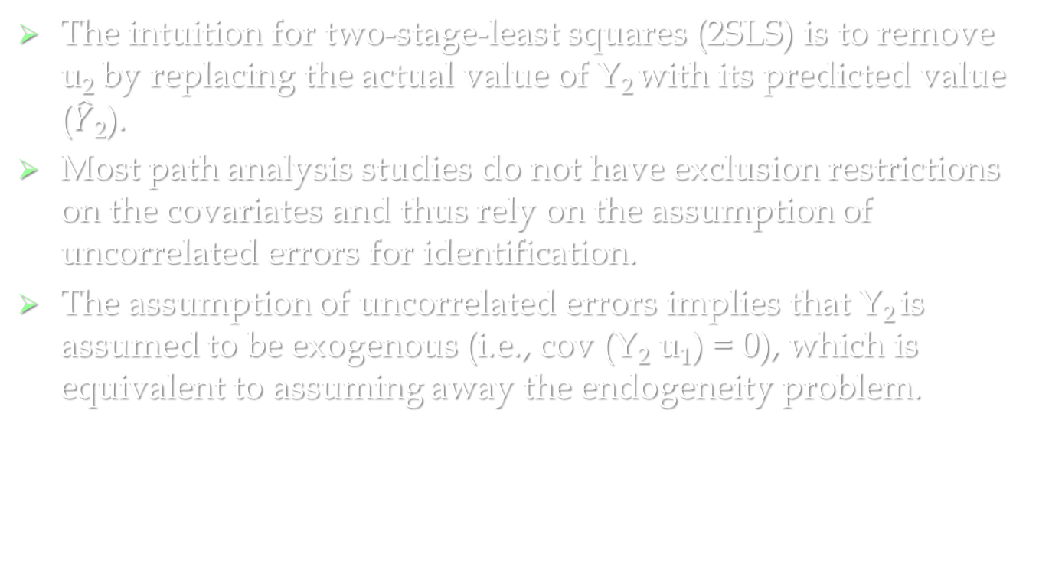
Lennox and Payne-Mann (2023)
The intuition for two-stage-least squares (2SLS) is to remove u₂ by replacing the actual value of Y₂ with its predicted value ($\hat{Y}$₂).
Most path analysis studies do not have exclusion restrictions on the covariates and thus rely on the assumption of uncorrelated errors for identification.
The assumption of uncorrelated errors implies that Y₂ is assumed to be exogenous (i.e., cov (Y₂ u₁) = 0), which is equivalent to assuming away the endogeneity problem.

Slide 16
Example
  lnaf = a₀ + a₁ lnta + a₂ lnsales + u
  lnta = b₀ + b₁ ln_sales + v
This system is “under-identified”
  regress lnaf lnta lnsales if miss==0
  sem (lnaf <- lnta lnsales) (lnta <- lnsales) if miss==0
It is estimated by imposing the assumption of uncorrelated errors (cov u v) = 0) which is equivalent to assuming away the endogeneity problem
Thus SEM gives the same output as OLS

Slide 19
Summary
There are two ways researchers can estimate a system of recursive equations.
  The first approach (IV) is to impose one or more exclusion restrictions on the exogenous covariates (α₄ = 0).
  The second approach is to assume uncorrelated errors (cov (u₁ u₂) = 0).
If neither approach is adopted, the Y₁ model is under-identified and the direct effect of the endogenous mediator (Y₂) on the main dependent variable (Y₁) cannot be estimated unless one assumes away the endogeneity problem by assuming uncorrelated errors.
The choice between imposing exclusion restrictions or uncorrelated errors is far from innocuous because the coefficient estimates depend on which approach is taken.
Moreover, the IV coefficients can vary depending on whether a system of equations is just-identified or over-identified.

Slide 20
Summary
There are three alternatives:
1) The researcher assumes uncorrelated errors.
  The estimated coefficients from path analysis are identical to OLS (see previous examples).
2) The researcher allows correlated errors in a just-identified system.
  The estimated coefficients from path analysis are identical to the coefficients from IV estimation
  sem (lnaf <- lnta lnsales) (lnta <- lnsales ln_age) if miss==0, cov(e.lnaf*e.lnta)
  ivregress 2sls lnaf lnta lnsales (lnta = lnsales ln_age) if miss==0

Slide 22
Summary
3) The researcher allows correlated errors in an over-identified system.
  The estimated coefficients from path analysis are different from IV but the IV estimates are also different depending on whether the researcher uses 2SLS, LIML or GMM
  sem (lnaf <- lnta lnsales) (lnta <- lnsales ln_age listed) if miss==0, cov(e.lnaf*e.lnta)
  ivregress 2sls lnaf lnsales (lnta = lnsales ln_age listed) if miss==0
  ivregress liml lnaf lnsales (lnta = lnsales ln_age listed) if miss==0
  ivregress gmm lnaf lnsales (lnta = lnsales ln_age listed) if miss==0
I’ll explain why they are different a bit later

Slide 24
Literature survey
How often is path analysis used in accounting?
Do studies use path analysis to draw causal inferences?
Do studies assume uncorrelated or correlated errors?

Slide 25
How often is path analysis used?

Slide 26
How often is path analysis used?

Slide 27
Do studies use path analysis to draw causal inferences?

Slide 28
Do studies assume uncorrelated or correlated errors?

Slide 29
An example
We replicate one of the path analyses in Li et al. (2021).
Li et al. (2021) test whether market liquidity is affected by mandatory IFRS adoption and whether this effect is mediated by disclosure quality.
We choose this study for a couple of reasons.
    the system of equations is over-identified, which means we are able to examine how varying the assumption of correlated versus uncorrelated errors affects the estimated coefficients.
    the study uses publicly available (or readily available) datasets.

Slide 30
Li et al. (2021)
Ln(PRC_IMPACT) = the natural log of the median Amihud (2002) illiquidity measure.
DQ = the number of line items reported in the financial statements.
Controls_{PRC} = POST, IFRS, POST × IFRS, the lagged number of zero returns days in the fiscal year, lagged size, and the lagged natural log of return volatility.
Controls_{DQ} are: POST, IFRS, POST × IFRS, size, leverage, sales growth, ROA, an M&A indicator, a Big 4 indicator, a qualified audit opinion indicator, the natural log of return volatility over the fiscal year, the natural log of a country’s GDP per capita, and the natural log of a country’s market capitalization per capita.
Note that Controls_{DQ} contains several variables that are not in Controls_{PRC}.

Slide 31
Li et al. (2021)
Similar to most path analysis studies, Li et al. (2021) do not disclose whether they assume correlated or uncorrelated errors.
Further, Li et al. (2021) do not attempt to justify their exclusion restrictions. We take their exclusion restrictions as given and explore the implications of assuming correlated or uncorrelated errors.
We estimate their system of equations twice, once under the assumption of uncorrelated errors (i.e., cov (u₁ u₂) = 0) and once under the assumption of correlated errors (i.e., cov (u₁ u₂) ≠ 0).

Slide 33
Takeaway
Altering the assumption of correlated or uncorrelated errors can flip the sign of the coefficient on the mediator and can dramatically impact the coefficient magnitudes.
We do not claim that every system of equations will see a sign flip when altering the error term assumption.

Slide 34
Over-identified systems
Recall that in an over-identified system in which the researcher allows correlated errors, the path coefficients are different from IV and the IV estimates are also different depending on whether the researcher uses 2SLS, LIML or GMM
The SEM command produces FIML estimates
In a just-identified system, the coefficients are identical regardless of whether the researcher uses FIML, LIML, 2SLS or GMM
In an over-identified system, the coefficients are different

Slide 35
LIML vs FIML
Both maximum likelihood estimators.
Under LIML each equation in the system is estimated individually, whereas under FIML the equations are estimated jointly.
Thus, in LIML, the over-identifying restrictions in the other equation are not considered when estimating the coefficients of the equation with the endogenous mediator.
In FIML, the over-identifying restrictions are taken into account when estimating the system.
Imposing an additional exclusion restriction allows FIML to use more information from which to generate the coefficient estimates.
Consequently, FIML estimates are different from, and asymptotically more efficient than, the coefficient estimates from LIML.
Despite this advantage, some researchers prefer LIML to FIML because the median LIML estimate is close to unbiased even when the chosen instruments (W and Z) are weak.

Slide 36

2SLS vs LIML
2SLS and LIML methods are both single-equation estimators.
They belong to a k-class suite of estimators in which the actual and predicted values of the endogenous regressor (Y₂) take a special form:
${Y_{2}}^{∗}=\left(1−k\right)Y_{2}+k\hat{Y_{2}}$ where 0 ≤ k ≤ 1.
In 2SLS, k = one; i.e., 2SLS uses the predicted value of the endogenous regressor ($\hat{Y_{2}}$).
In OLS, k = 0 (i.e., OLS uses the actual value of Y₂ because Y₂ is assumed to be exogenous).
LIML generates an estimated value of k (0 ≤ k ≤ 1) based on the specific features of the system.
In a just-identified LIML system, k = one, which is why LIML and 2SLS produce the same coefficient estimates.
In an over-identified system, the estimated value of k deviates from one, which is why LIML generates different coefficient estimates from 2SLS.

Slide 37
GMM
GMM is a separate class of estimator based on moment functions.
In just-identified systems, GMM has moment conditions that exactly align to those of 2SLS.
Therefore, in just-identified systems, the GMM coefficients are identical to 2SLS (as well as LIML and FIML).
In over-identified systems, GMM relies on a weighting matrix to generate coefficient estimates, with the matrix also being estimated. Consequently, the GMM coefficients are different from other estimation methods (2SLS, LIML, FIML) when the system of equations is over-identified.

Slide 38
Recommendations
Disclose whether the errors are assumed to be correlated or uncorrelated.
When assuming uncorrelated errors, justify the assumption.
Do not over-claim the benefits of path analysis.
Disclose whether exclusion restrictions are imposed on the covariates.
Consider whether path analysis or instrumental variable estimation is more appropriate.
  Is it more reasonable to assume uncorrelated errors or is it more reasonable to assume exclusion restrictions?
  If neither assumption is reasonable, avoid using path analysis and IV estimation
BIG PICTURE RECOMMENDATION
  Don’t use methods that you don’t understand!

Slide 39
Recommendations
GOLDEN RULE
  Don’t use a method that you don’t understand!

